Slide 1
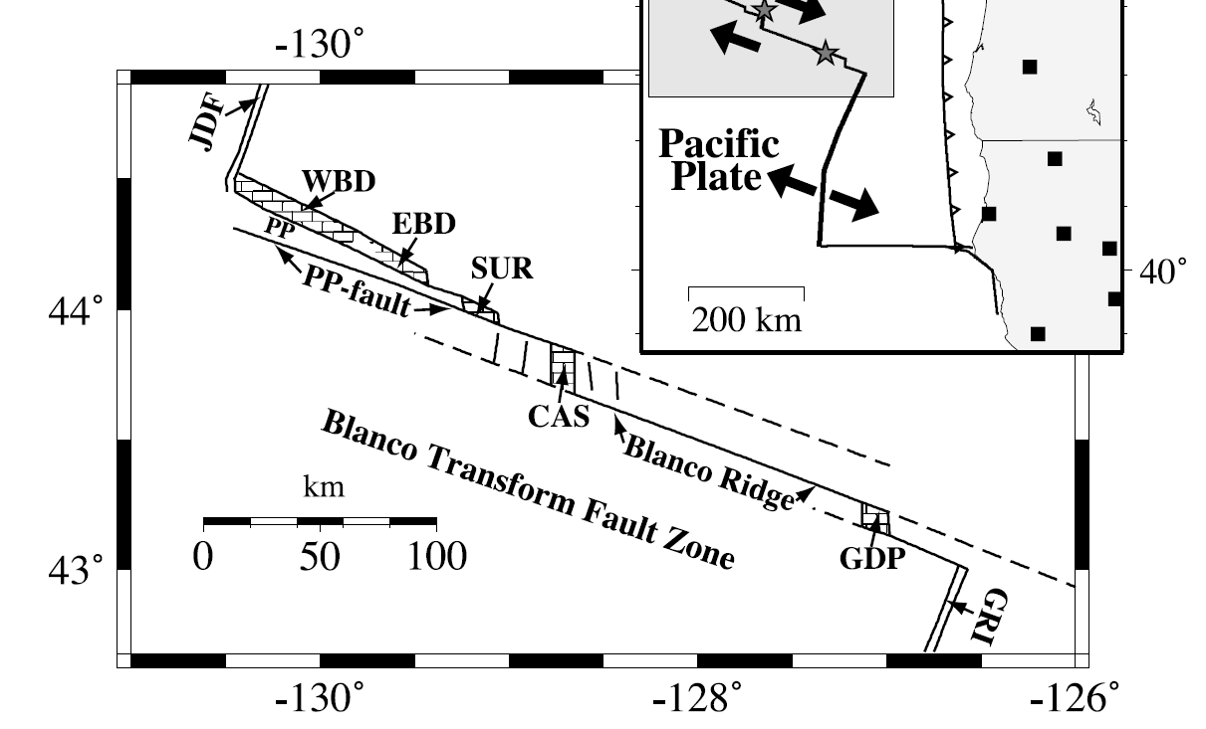
-131.047
44.9
42.68

